Slide 1
Engineering Economics in Software Architecture
REMINDER: all this is fair game for exams!
Stephen Riley, MSE ‘07
Sr. Director, Engineering
Apptio

Slide 2
Agenda
Ridiculously inadequate intro to Engineering Economics
Applying Eng’g Econ to software architecture
Q & A (about anything)

Slide 3
Engineering Econ
An entirely inadequate introduction

Slide 4
THIS IS HOW ALL SOFTWARE DESIGN / ARCHITECTURE DECISIONS SHOULD BE MADE.

Slide 5
What is Eng’g Econ?
A rational and deliberate way to expend resources most efficiently toward the benefit of the organization.
A cost-based way to make engineering decisions!

Slide 6
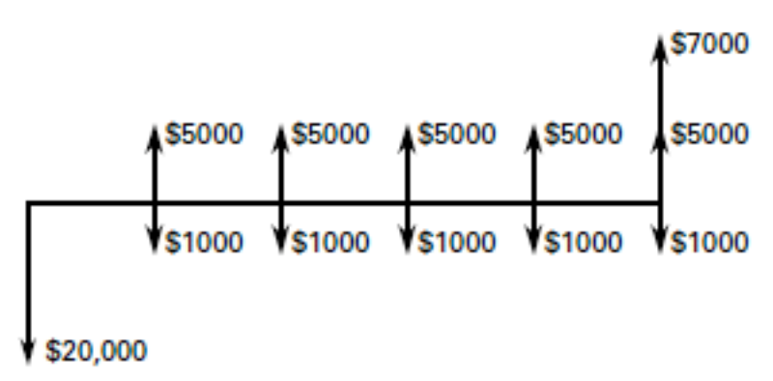
Cash Flow Diagrams
A brute-force way of showing the economics of a situation.

Slide 7
Fundamentals of Eng’g Econ
Time-value of money
Present value of future money
Future value of present money
Interest rates/inflation
Comparison of alternatives
Should I do A or B? (Cost-benefit and ROI)
A (sort-of) way to measure opportunity cost

Slide 8
Time-value of money
P/F
F/P
Interest rates
Annuities (P/A)
Not going to get into it

Slide 9
Comparison of Alternatives
Very simple:
WHAT COSTS LESS?
(Remember the planning horizon)
Notes:
Sometimes the alternatives have very different timelines, planning horizons, etc. You have to rationalize them to make a fair comparison.

Slide 10
The Do-Nothing Alternative
Which is cheaper?
Alternative A
Alternative B
Doing nothing at all
How much does it cost to leave well enough alone?
Always always always always always evaluate this!
Notes:
Sometimes throwing bodies at the problem really is the most economic!

Slide 11
Opportunity cost
What you’re not getting by doing something
What are you losing the opportunity to do?
Example: going to grad school
Obvious costs: tuition, books
Benefits: Better job prospects, bragging rights
Non-obvious costs: Child care? Social life?

Slide 12

Opportunity cost
The true cost of doing something is always actual + opportunity

Slide 13

Measuring opportunity cost
How do you measure the future?!
Put a dollar figure on all initiatives
It’s hard, but you can estimate it
Use opportunity cost as a sniff test
Notes:
For all initiatives, figure out what the dollar value is:
Product for sale? It’s the sales estimate
Efficiency initiative in-house? It’s the salary of the people’s time you’re saving
That way, when you’re measuring opportunity cost, you can see what you’re NOT earning/saving

Slide 14
Measuring opportunity cost
Case study: that discussion you had last week about just making it up as you go, Agile-style
Notes:
Whether the Agile approach of make it up as you go
“You can fix it later”
If you have put a dollar figure on all initiatives, you can see how much you’re NOT earning/saving by re-doing architecture

Slide 15
Questions?
(don’t worry, we’ll see this again)

Slide 16
E-Econ applied to software…

Slide 17
“Technology starts and ends with people.”
So let’s look at the start…

Slide 18
Questions software architects often ask
What tech should I use?
How much will my stack cost?

Slide 19
Questions software architects rarely ask (but should!)
Is this tech too new? Too old?
Do I have the right people?
Can I hire the people I need?
Is there marketing buzz to jump in on?
How long will this system be alive?
Does anyone really know the requirements?
Can we get a tax break?
How much will this actually cost?!

Slide 20
In other words…
Management
HR
CFO
Marketing
Sales
Local economy
…these people all get consideration!

Slide 21


Slide 22
Questions software architects rarely ask (but should!)
Is this tech too new? Too old?
Do I have the right people?
Can I hire the people I need?
Is there marketing buzz to jump in on?
How long will this system be alive?
Does anyone really know the requirements?
Can we get a tax break?
How much will this actually cost?!

Slide 23
Is the tech too new? Too old?
Old
Pros: proven tech, lots of docs
Cons: availability, cost, and quality of engineers
New
Pros: The New Hotness™! Lots of excited engineers
Cons: not proven in market, lots of bugs, quality of engineers
Local market, HR

Slide 24
Do I have the right people?
Be honest
Consider experience and potential
Tradeoffs
Team up for The New Hotness™?
Use known techniques?
Can you hire quickly enough?

Slide 25
Can I hire the people I need?
Short answer: NOT TODAY!
Planning considerations:
30 days for a junior
60 for mid
90 for senior
??? for principal
15-20% of first year’s salary for recruiting
People don’t grow on trees. Don’t pretend they do.

Slide 26
Marketing buzz?
Your tech decisions can drive marketing!
Yes, it’s BS.
Yes, it matters!
Eg. Deep Learning, Big Data, Microservice Architecture, Cloud, SOA…
Marketing buzz ==
Better hiring
Enterprise sales lift
Better hiring

Slide 27
How long will this live?
(AKA “planning horizon”)
Might be longer than you think… Be realistic!
75-80% of a project’s cost comes after 1.0!
Depreciation

Slide 28
Who knows the requirements?
#1 killer of projects: bad requirements
This might be your first job!
Don’t commit to budget until you are confident of this!
Time-box becoming an “expert”
“90-day rule”

Slide 29
Tax breaks?
Building a new project counts as a “capital expenditure” (CAPEX)
Maintenance counts as “operational expenditure” (OPEX)
CAPEX is depreciable
CAPEX effectively reduces OPEX on the balance sheet (GAAP)
Notes:
R&D as a discriminator: you cannot capitalize Research, but you can Development
Interesting as it applies to ML

Slide 30
So how much does it actually cost?
It ain’t just tech!
In fact, when you lay it all out, it’s mostly not tech!
(People and business issues will sink your project’s chances more than tech issues)

Slide 31
Budgets
Usually by month
As much about time as money
Cheat sheet:
Dev equipment per person
Infrastructure cost (eg. Cloud services)
Cost per person (loaded vs. salary)
Recruiting costs
Ramp-up time (project and people)
Time per week per person on project (80% max!)
Management functions (“Rule of 5”)
CAPEX and OPEX separately
Customer support load
IT load (if any)
COGS (ask the CFO)
G&A (ask the CFO)

Slide 32
References
Return on Software, Steve Tockey
en.wikipedia.org/wiki/Engineering_economics
en.wikipedia.org/wiki/Industrial_engineering

